Slide 1
Image Mosaic
by
Karan Shah
Francesco Spadafora
Notes:
Francesco

Slide 2
Outline

Slide 3
Outline
Motivation
Algorithm
Panorama Examples
Future Work

Slide 4
Motivation
Notes:
Francesco

Slide 5
Motivation
No built-in function
Fun topic
Panorama pictures from campus
Notes:
No buil-in function in MATLAB, Fun topic to work on, find an excuse to walk though campus and take pictures
(Computer Vision Toolbox) → Francesco

Slide 6
Algorithm
Notes:
Francesco

Slide 7
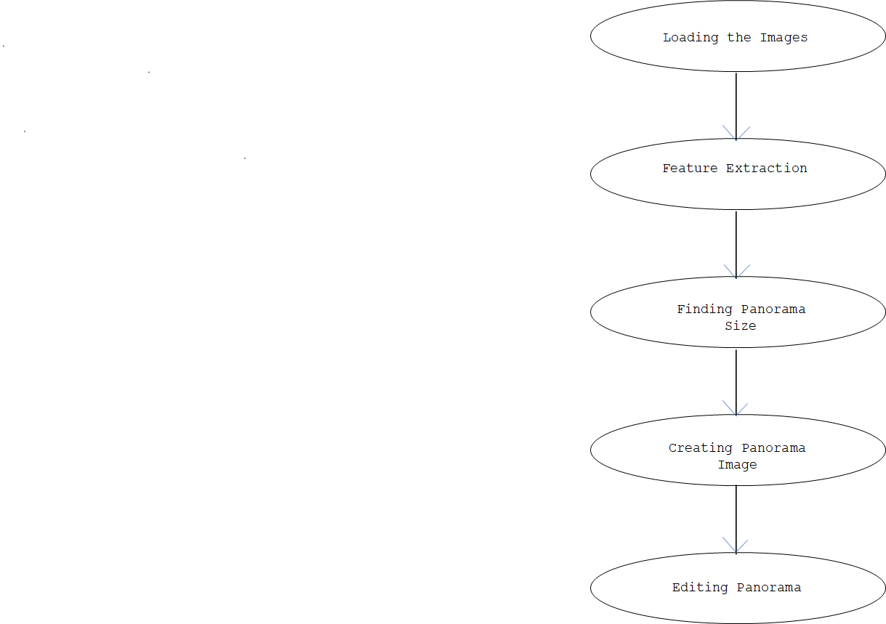
Algorithm
Image Loading
Image Registration
Image Blending
Stitching
Notes:
Go over the graph -->Francesco
Say: Algorithm decided to use, like introduced in class, load images, extraction, size, create stitching with transformation matrix, one in center less stitched than outner ones, cut panorama

Slide 8
Panorama Example 1

Slide 9
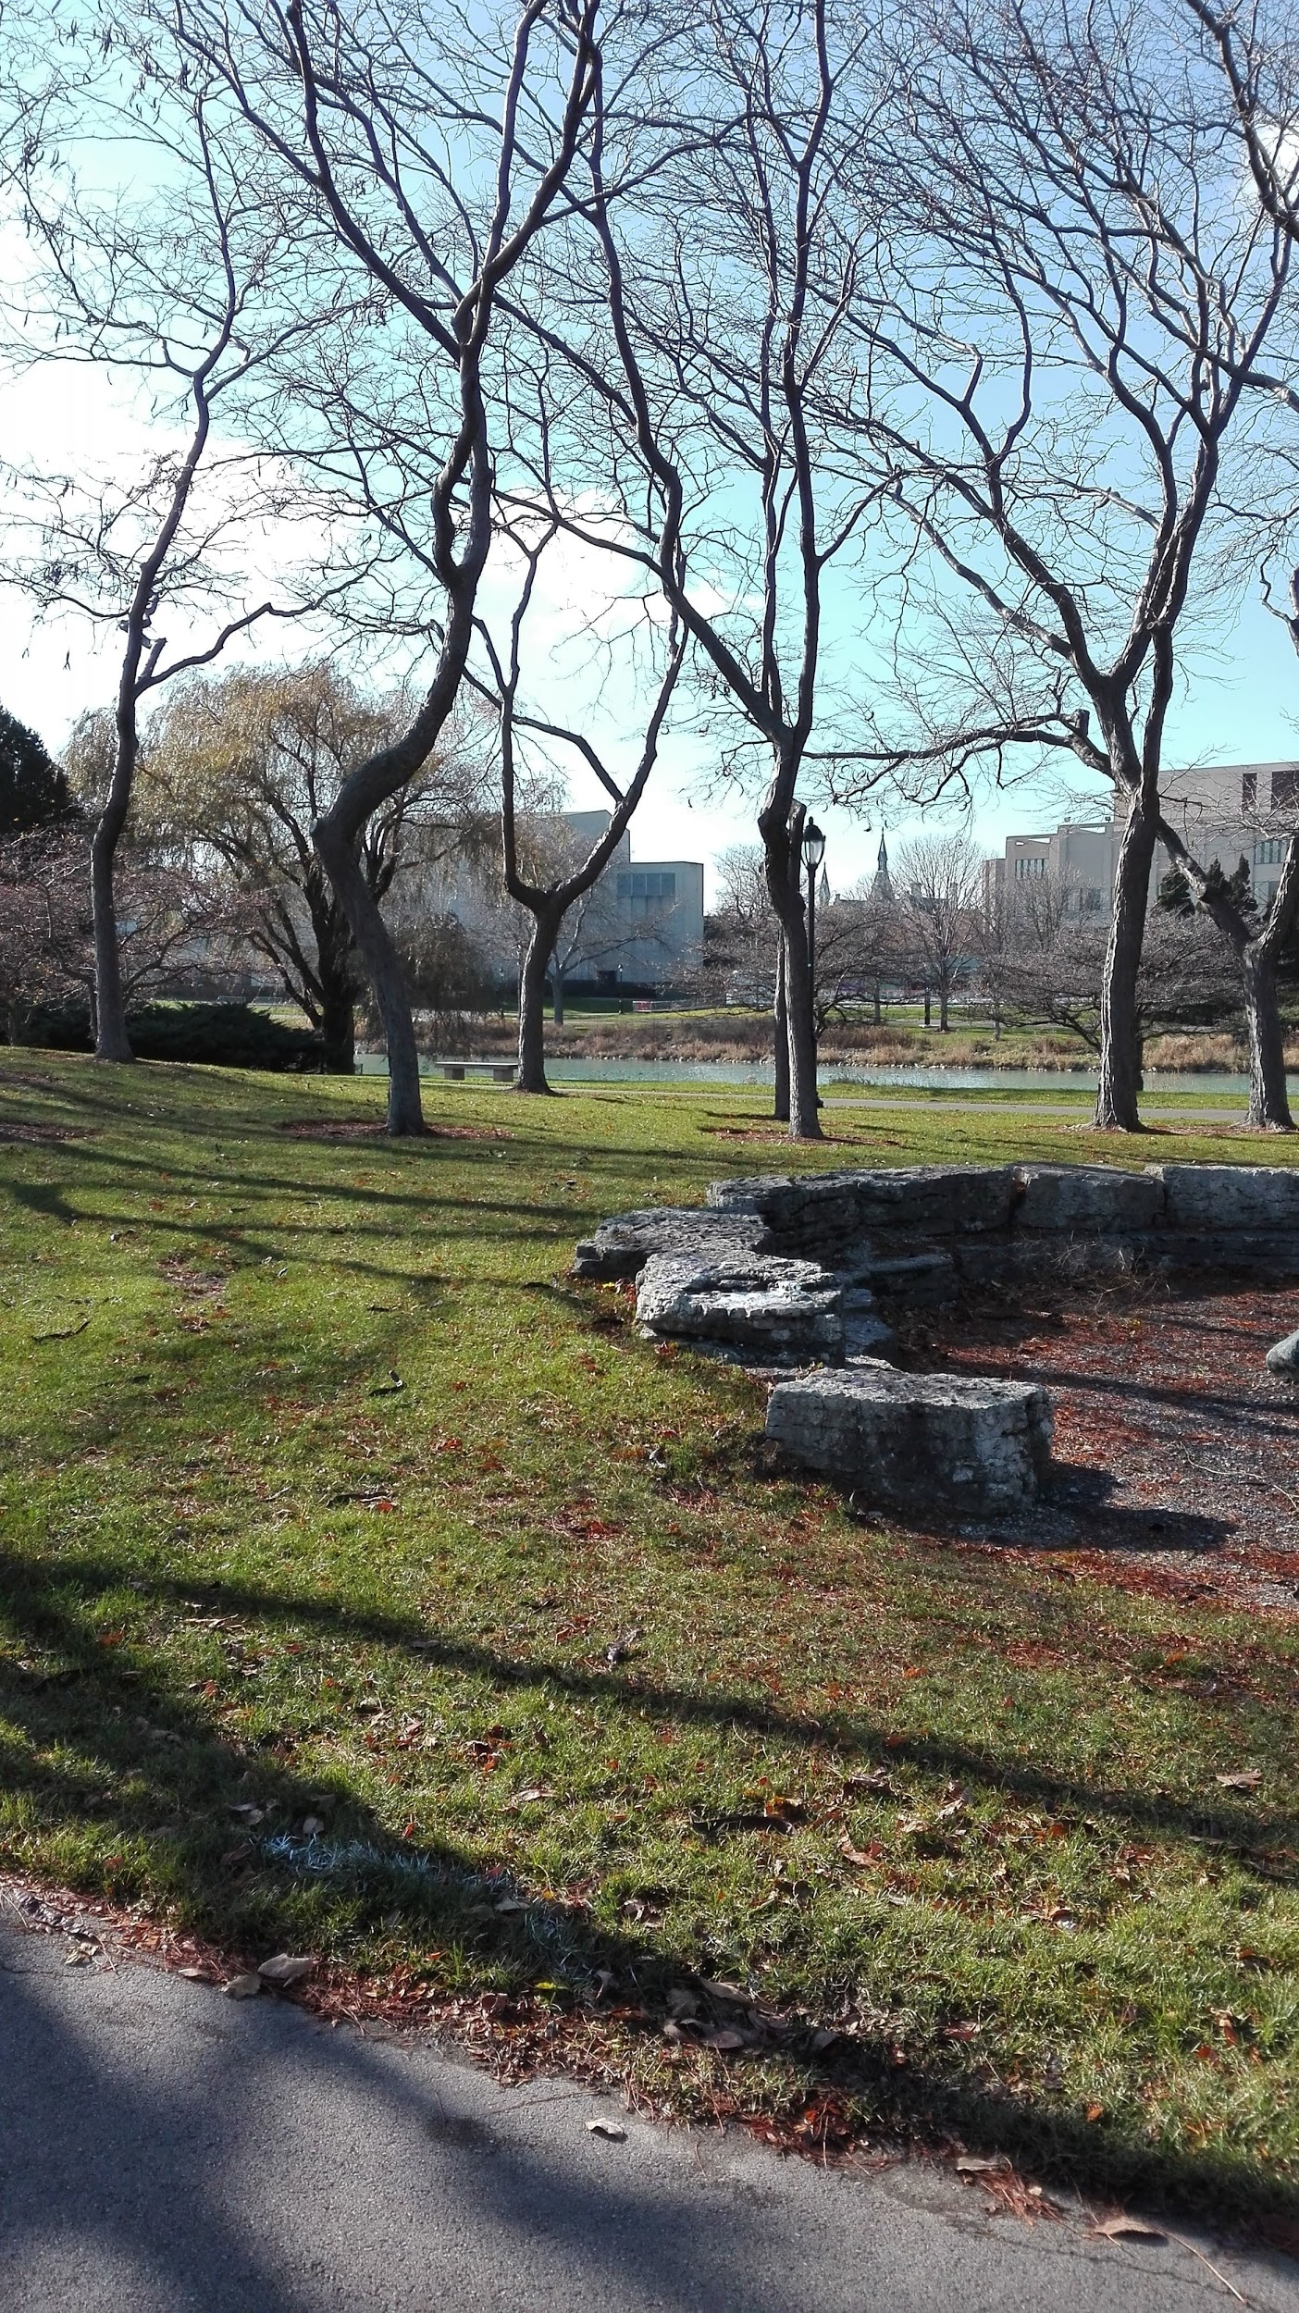
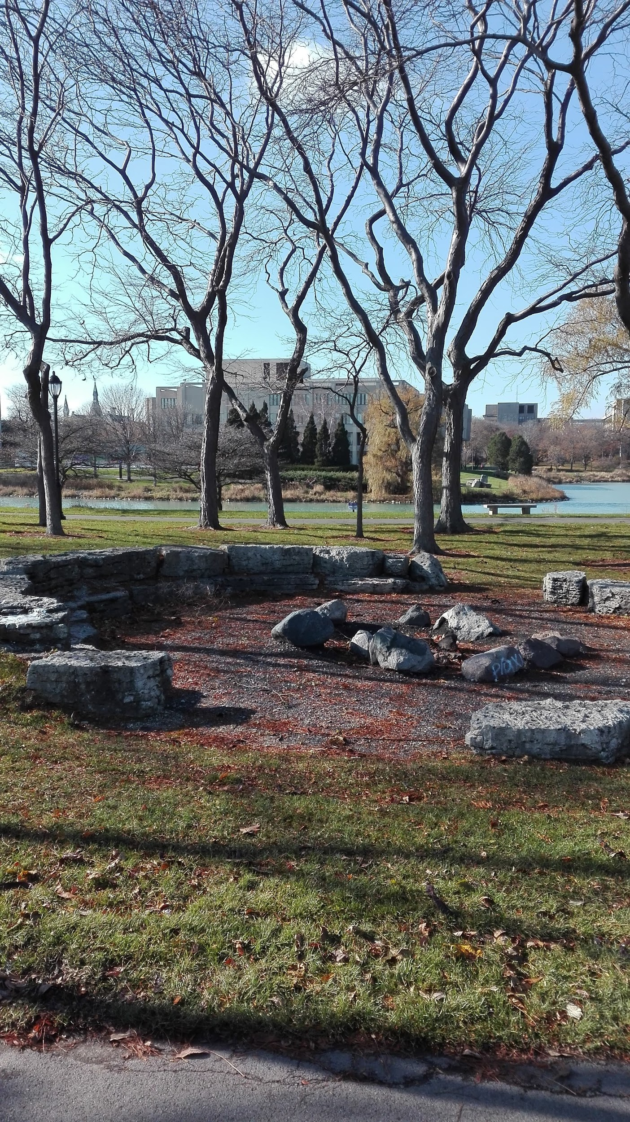
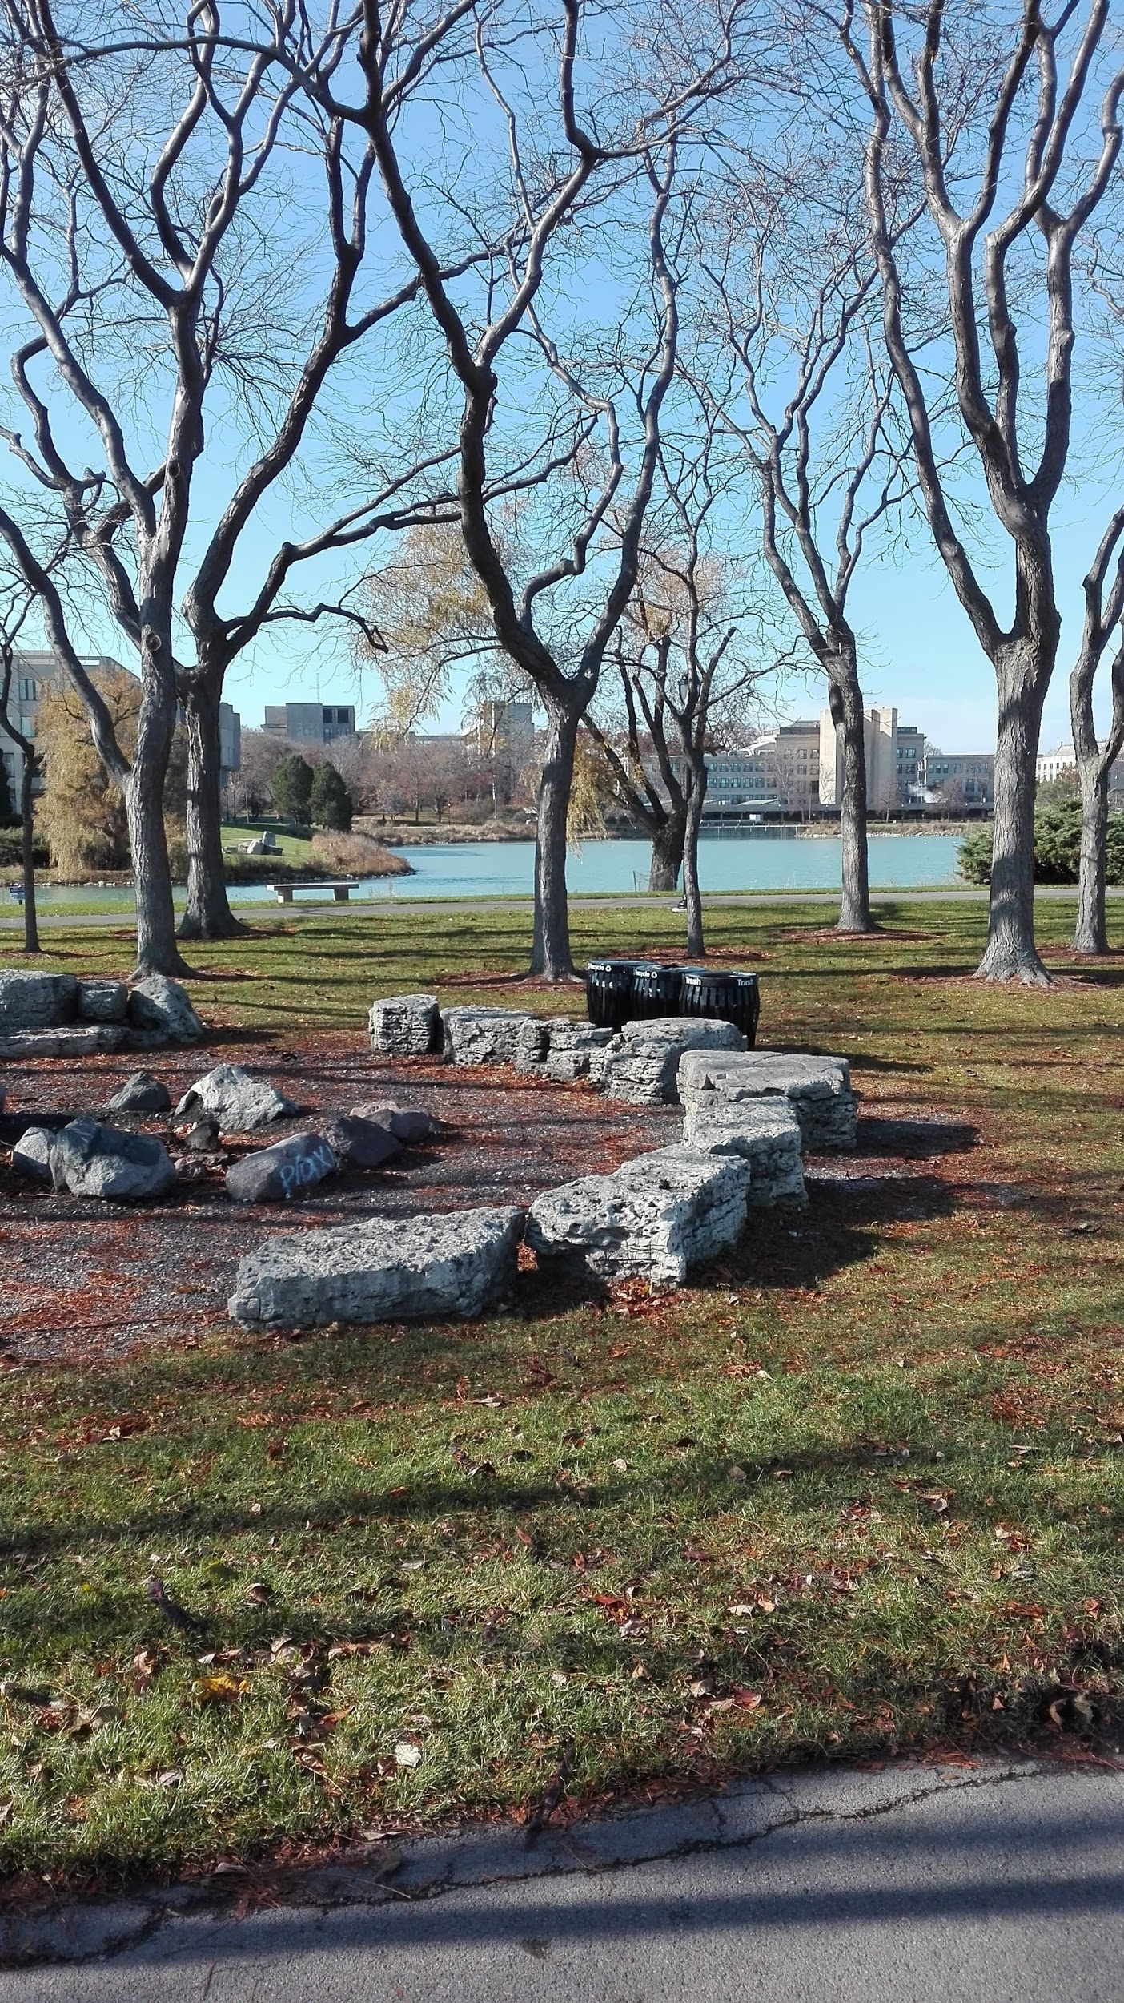
Input Images
Notes:
Francesco

Slide 10
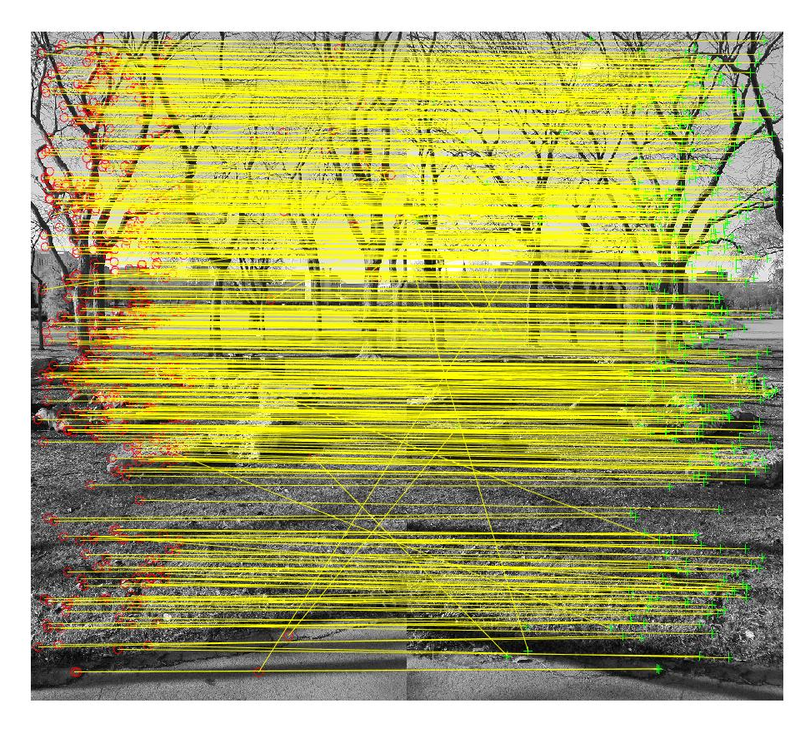
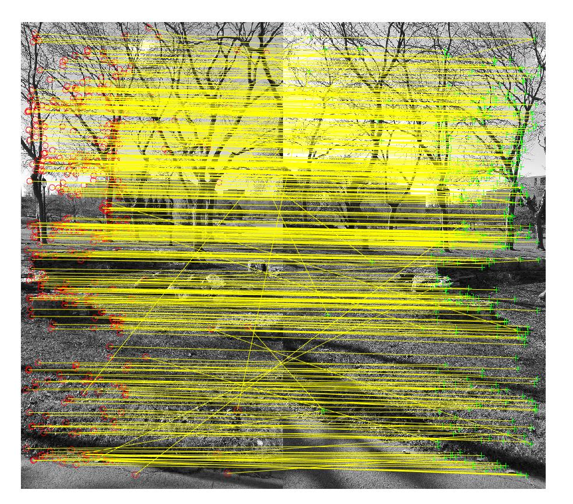
Feature Matching
Notes:
Francesco

Slide 11
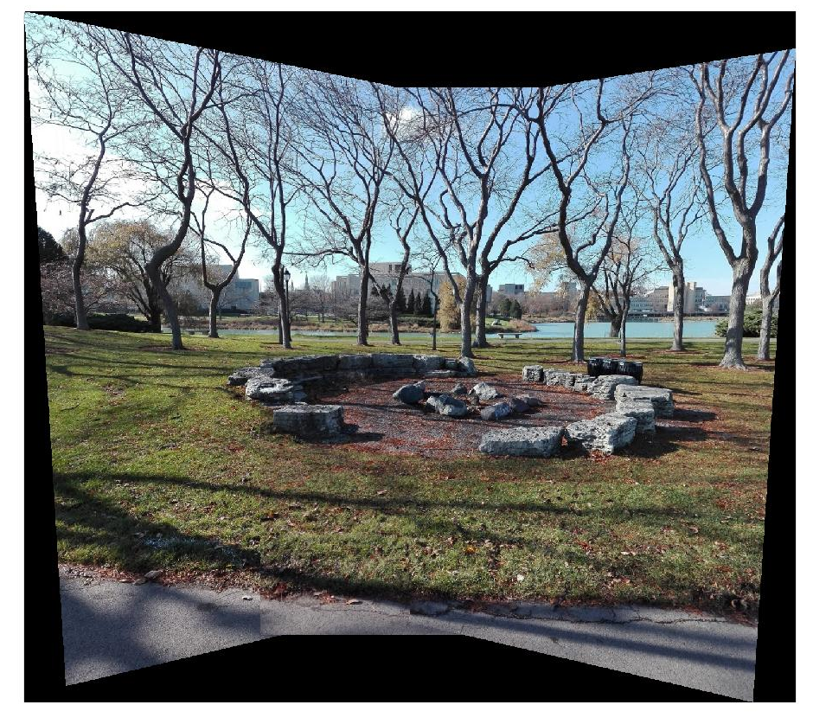
Stitched Image
Image Registration
Image Blending
Notes:
Francesco

Slide 12
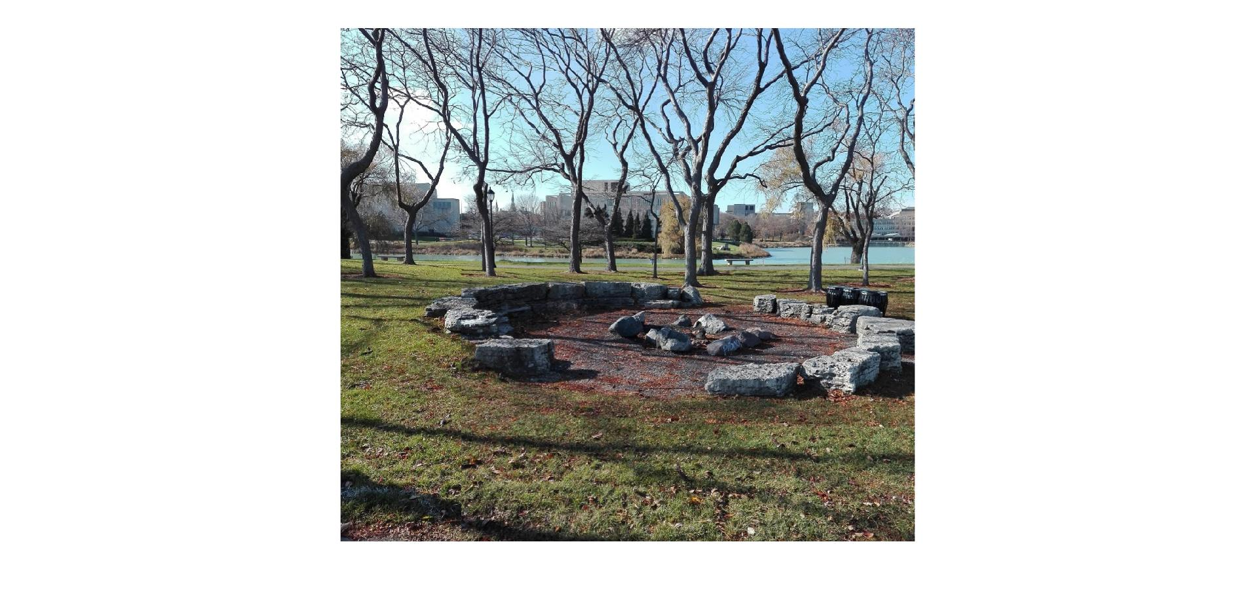
Panorama Image
Cut out edges
Notes:
Francesco → For second example, hand over to Karan

Slide 13
Panorama Example 2

Slide 14
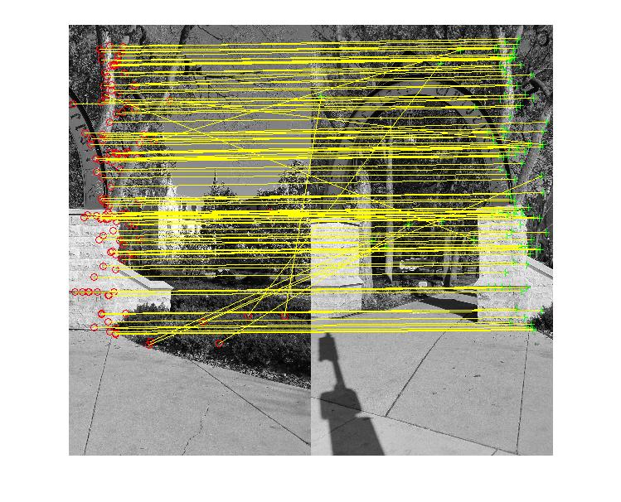
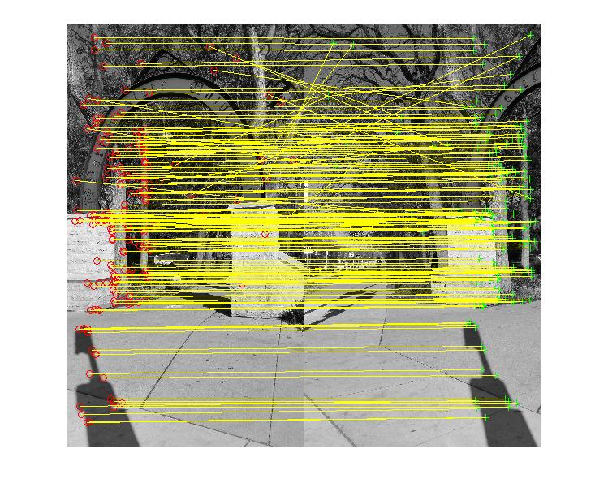
Feature Matching
Notes:
karan → Less features, different contrast of images, incorrect feature matching compared to image 1.

Slide 15
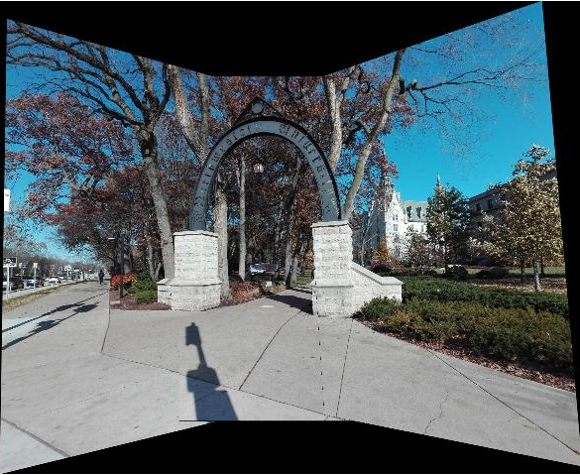
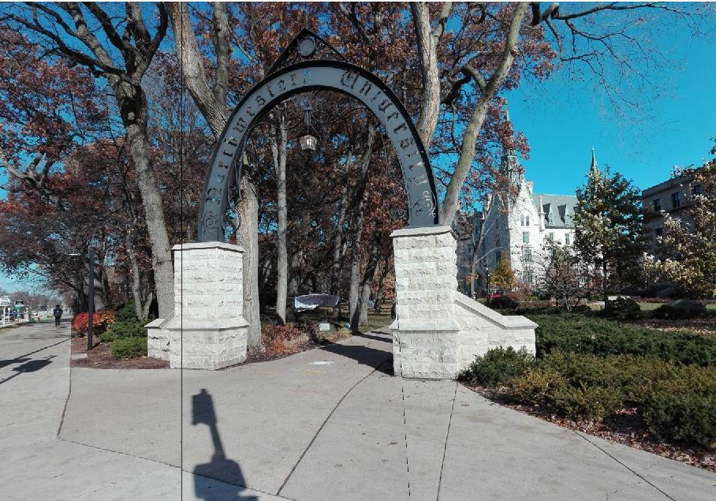
Output Images
Notes:
Karan
Supress lines by changing contrast of images, feature retratction should be properly done (more feature metching), better stitching, more points

Slide 16
Future Work
Notes:
Karan

Slide 17
Future Work
Automated function for obtaining maximal cutout of the panorama
Implementing a rigorous algorithm for blending as no edges can be seen
Auto detection of input images
Include an resize function
Notes:
Karan

Slide 18
Q & A

Slide 19
Thank you

